Slide 1
T-test

Slide 2
A procedure used to compare sample means to see if there is sufficient evidence to infer that the means of the corresponding population distributions also differ.
To determine if two sets of data are significantly
different from each other.

Slide 3
Types of t- test,
One-sample t- test
Independent sample t - test
Paired- sample t- test

Slide 4
One sample t-test
A one sample t-test allows us to test whether a sample mean (of a normally distributed interval variable) significantly differs from a hypothesized value.
The one-sample t-test is used to determine whether a sample comes from a population with a specific mean. This population mean is not always known, but is sometimes hypothesized.

Slide 5
Assumptions
dependent variable should be measured at the interval or ratio level
independent (i.e., not correlated/related),
no significant outliers.
dependent variable should be approximately normally distributed

Slide 6
One sample t test
Objective
To compare the present class percent against the standard

Slide 7
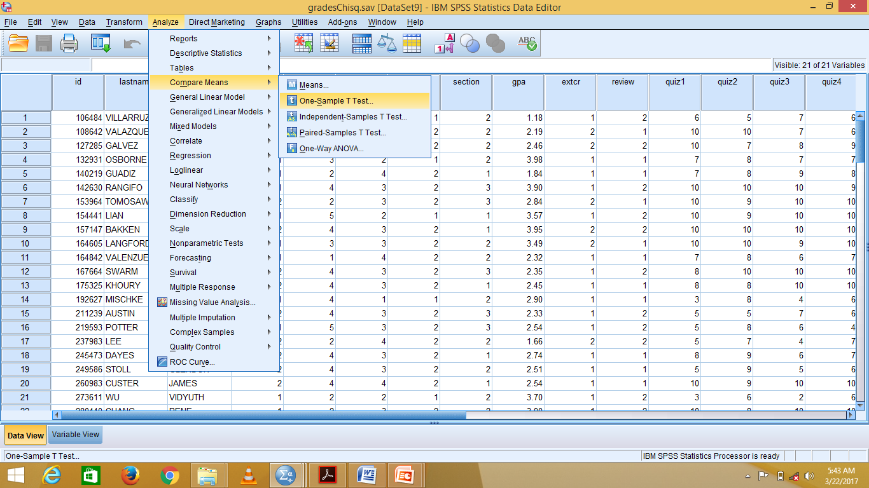

Slide 8
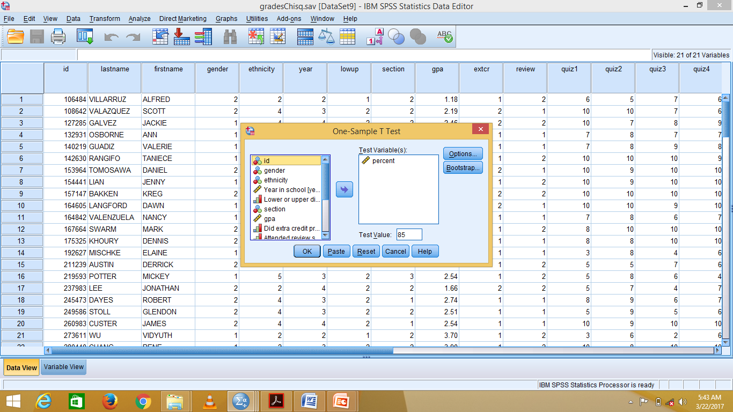
Select percent , move to test variable Set test value as 85 and Click ok

Slide 9
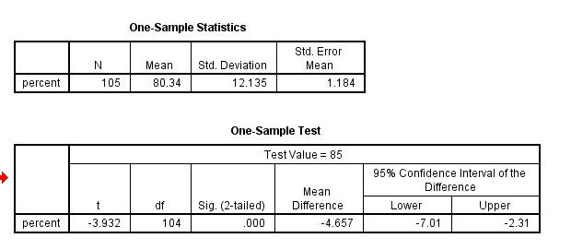
The Mean percent for the class (N= 105, M=80.034) was significantly lower ( p is 0.001) than the instructor’s goal(test value)of 85%.

Slide 10
Independent samples t test
compares the means between two unrelated groups, in which Independent variable is categorical and dependent variable as continuous scale.

Slide 11
Assumptions
dependent variable should be measured on a continuous(ratio / interval )scale
independent variable should consist of two categorical, independent groups.
no significant outliers( use boxplots)
normally distributed ( use Shapiro-Wilk test of normality )
homogeneity of variances.(using Levene’s test for homogeneity of variances.)

Slide 12

OBJECTIVE Whether, gender influences the perception rating of coke? (i.e. Whether, male and female perceive coke differently) Q1 Vs.Q27 Q1. Gender : 1.Male 2.Female
Whether a nominal (2 levels) influences a scale.
Independent samples t test

Slide 13
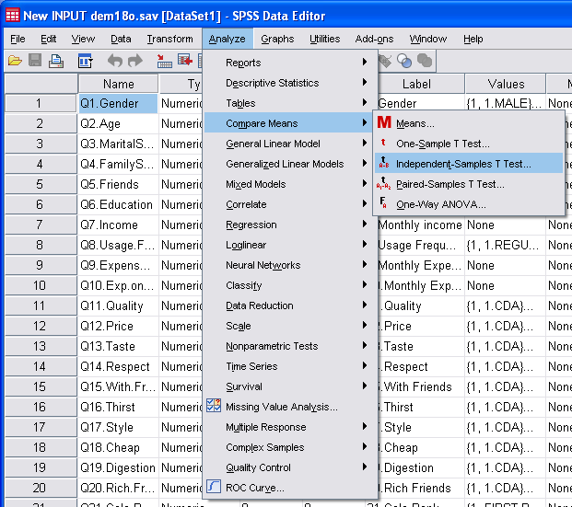
1)Analyze > compare means > independent samples t test

Slide 14
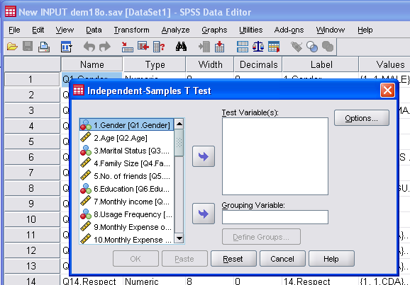
Pop up appears…

Slide 15
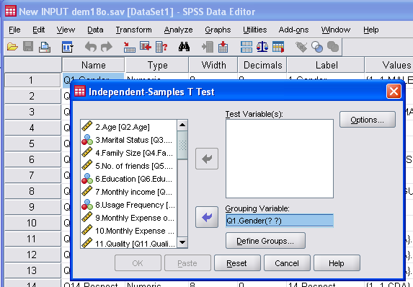
3)Transfer nominal variable(Q1.Gender) to Grouping variable box

Slide 16
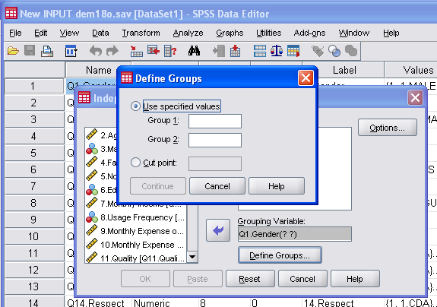
4)click..Define range Pop up appears

Slide 17

5) Type ‘1’ in Group 1 and ‘2’ in Group 2 click ..continue

Slide 18
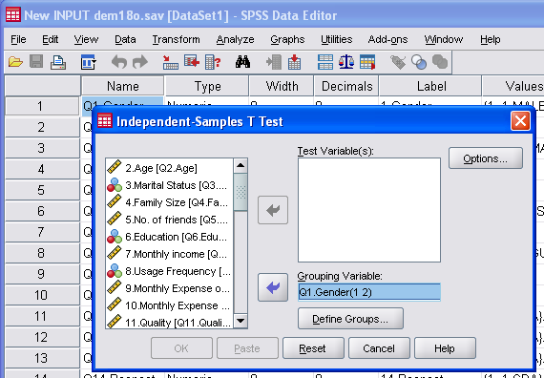
6)Number 1& 2 appears in the Grouping variable box

Slide 19
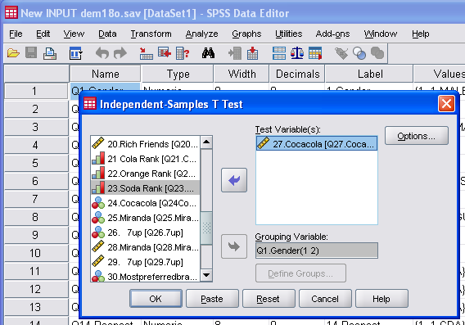
7)Transfer the scale variable(Q27.coke rating) to test variable box and click ok

Slide 20

OUTPUT
Male are Highly satisfied (4.72),
while Female are Satisfied (3.7)

Slide 21
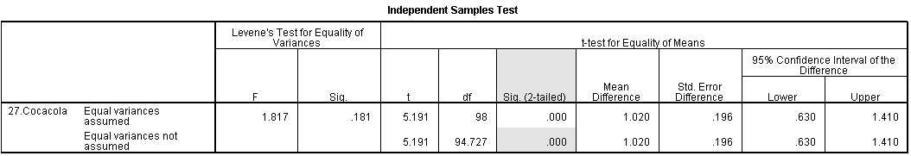
Is the difference between means significant?
Sig. <0.05 .
so the mean difference is significant.
Hence Gender influences the perception of coke.

Slide 22
t-Test in R
a<-read.csv(“softdrink.csv")
m<-a$Q27.Cocacola [a$Q1.Gender==1]
f<-a$Q27.Cocacola [a$Q1.Gender==2]
hist(m)
hist(f)
tt<-t.test(m,f)

Slide 23
Paired sample t test
The purpose of the test is to determine whether there is statistical evidence that the mean difference between paired observations on a particular outcome is significantly different from zero. It is a parametric test. This test is also known as: Dependent t Test.
Example: understand whether there was a difference in managers' performance before and after undertaking a PhD

Slide 24
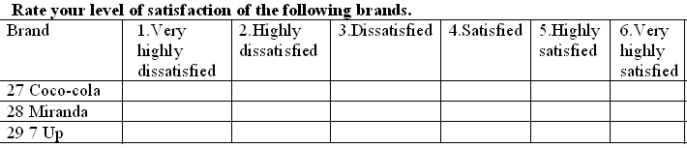
OBJECTIVE 1 1. Are Miranda and 7up perceived differently?
Are the means of Q28 & 29 different?
Are the means of two scale variables different?
Paired sample t test

Slide 25
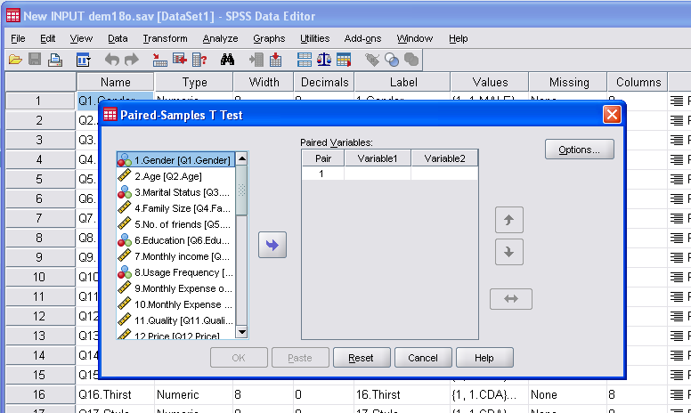
1)Analyze > compare means > Paired sample t test

Slide 26
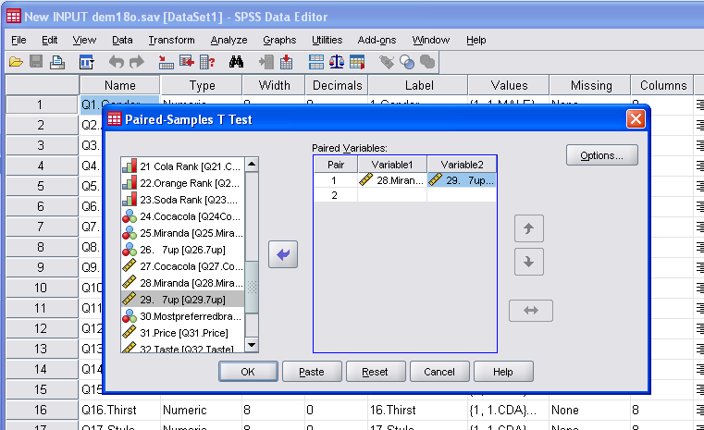
2)Transfer two scale questions(Q28&29) to right .click..OK….Output appears

Slide 27

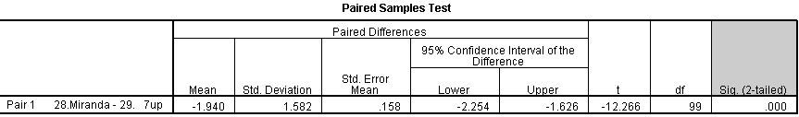
OUTPUT
People are dissatisfied/neutral (mean 3.3) with Miranda while highly satisfied(mean 5.24) with 7 up ,
Sig. <0.05 .so Miranda and 7up are perceived differently

Slide 28
Thank You

